Slide 1

Crime Analysis Project
Prepared for P.C. Labs
Data Big Big, Think Big Analytics
July 2017
Notes:
Several alternative title slide layouts are available toward the end of this template deck.

Slide 2

Notes:
We want to start with a story we read in the newspaper a few days ago. It was used in another context, but we still find it relevant to our case.
In 1965, Andre-Francois Raffray, a 47 year old layer, made the deal of his life. He persuaded a window, who owned an apartment in Arles, that if he paid 500$ per month until she died, she would leave him the apartment in her will. She was already 90 years old, so this seemed a very safe bet.
However, 30 years later, Mr. Raffray was dead, and the old widow was still going strong.
When she finally died, at age 122, the Raffray family had paid her more than twice the value of the home.
--
What can we learn from this story?
We read a few things:
Using popular knowledge and intuition to make decisions works many times -> But it can also turn out to be very wrong
Having the wrong estimates can be very expensive
In any case, you do not want to operate in the dark, like the boy in the picture, without data and information that supports your decisión.
This is what our presentation, for crime-related predictions, is about.

Slide 3

Agenda
Solution implemented in Pilot
Analysis and findings from Pilot
Proposal for next steps
3

Slide 4
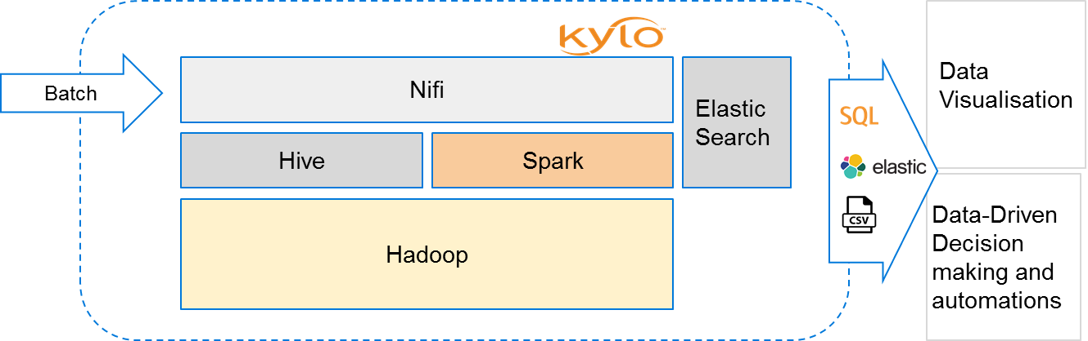
Solution Implemented
Self service data lake for BI and data scientists
Version controlled
Data analysis workflows running in the cluster
Operational solution, maintainable by P.C Labs
Notes:
As we promised, we deliver you the solution.
Self service data lake for BI and data scientists.
All our work are version controlled.
Data analysis workflows are already on the cluster, you can access the results via different interfaces(sql/elasticsearch..), so you can apply the insights faster.

Slide 5

Analysis and findings
Identify the hot-spots for homicide in the world.
Correlate homicide rates across countries over time.
Make prediction model for crime rate using various social indicators.

Slide 6
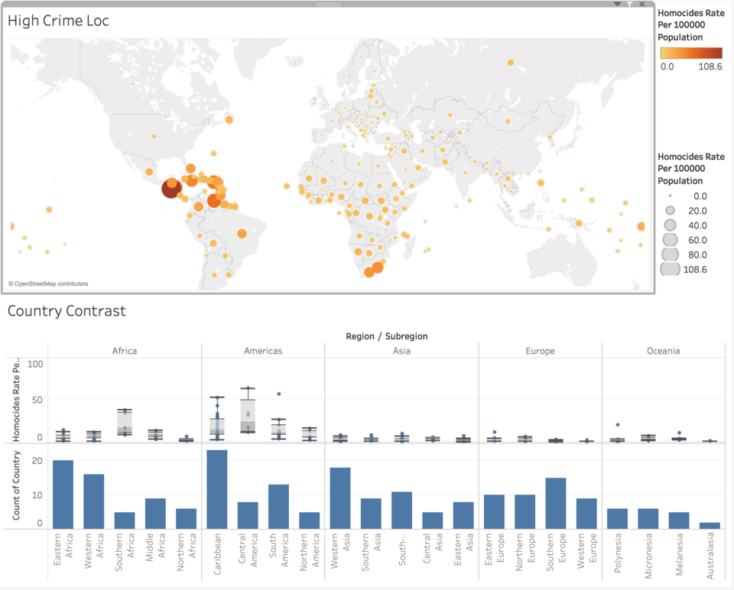
Hot-spots for homicide in the world

Slide 7
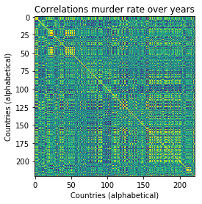
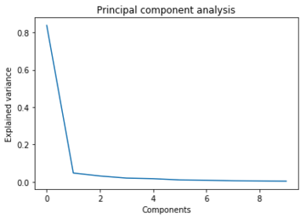
Correlation of homicide rates across countries over time

Slide 8
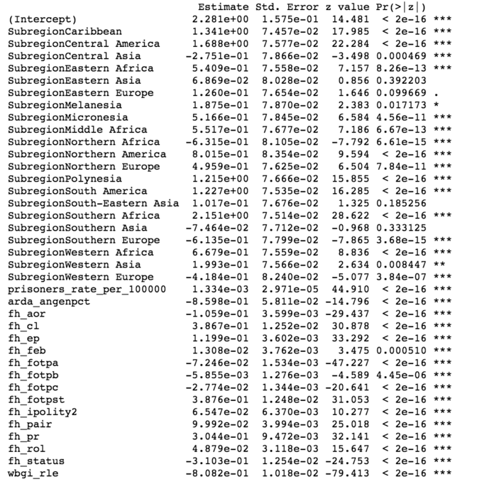
Prediction model using various social indicators
Predictor variables
Religion
Regulation on Media
Rule of law

Slide 9
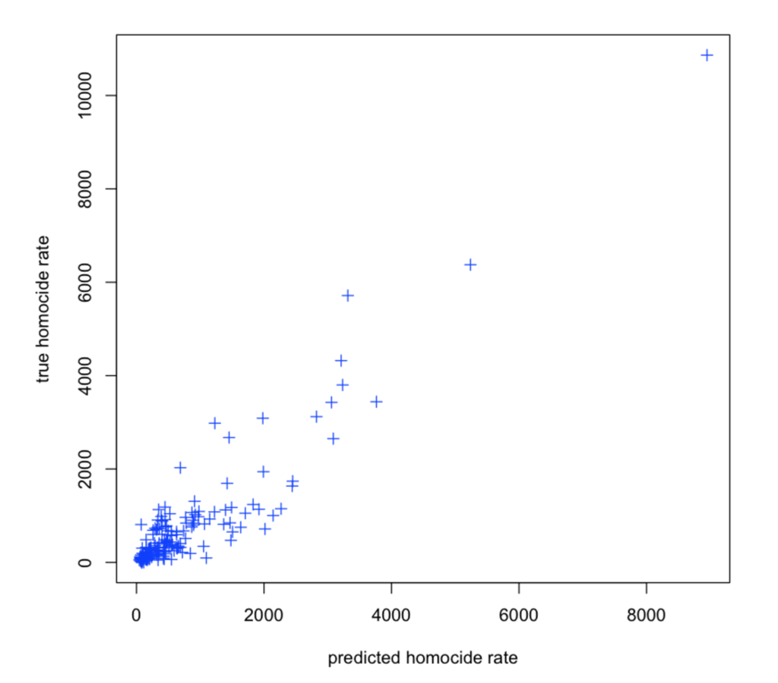
Prediction model using various social indicators
R²= 96%
Notes:
You can use this model to predict the crime rate based on the indicator values, taken a country as input
This plot demostrates that our model performs well

Slide 10

We help you...
Find out where to invest your money best
Use big data to make further wise decisions
Be better than your competitors
Notes:
There are some of the very important things we will help you with:
Gain insights and find opportunity of expanding your current business
Obtain critical information to get the best out of your investments
Increase competitive advantage over other security companies

Slide 11

Next Steps

Slide 12




Continue developing new use cases
Predict high terror risk regions, generate early alerts
Stream images from real-time surveillance cameras, social networks to detect suspicious criminals
Discover the cause of certain types of criminal activities and cure it with special information
Utilize satellite images of other planets to detect anomalies and protect the life on earth
3
20 years…
Notes:
We think you should continue developing new use cases, to implenet more advance crime detection solutions that bring more value
From the presentation last week, we think the first two cases are a really good place to start.

Slide 13
Proposal for Next Steps - Timeline
2017 Aug Sept Oct Nov Dec
Mature Big Data platform
Incorporation of new data sources
Real time data flows
Deployment in mobile apps
Big scale implementation of models from Pilot
Predict high terror risk regions, generate early alerts
Training
Priorities and possibilities for expansion will be discussed on an ongoing basis
Solution and cluster can be managed by Think Big, or handed over to P.C Labs
We would prefer staffing the team with join resources PC Labs + Think Big
Notes:
Mature Big Data platform : Data cleansing not automated yet

Slide 14
Financials
The estimate for this proposal is 800,000 GBP.
Time-boxed approach, based on 5 FTEs
Excludes travel expenses (estimated to be negligible), VAT and technology costs.
The costs for the rest of the roadmap will be evaluated after the Pilot.
Notes:
Please, let us know what you think about our proposal and what are the next steps for our engagement

Slide 15
Notes:
Closing slide for all presentations

Slide 16

Crime Analysis Project
Prepared for P.C. Labs
Data Big Big, Think Big Analytics
July 2017
Notes:
Several alternative title slide layouts are available toward the end of this template deck.

Slide 17

Crime Analysis Project
Prepared for P.C. Labs
Data Big Big, Think Big Analytics
July 2017
Notes:
Several alternative title slide layouts are available toward the end of this template deck.

